Slide 1

Computer Graphics
Deepankar Sharma

Slide 2
Introduction to Computer Graphics: • Definition, • Applications, • Graphics Hardware, • Display Devices: § Refresh Cathode Ray Tube, § Raster Scan Display, § Plasma display, § Liquid Crystal display, § Plotters, § Printers.

Slide 3
Definition

Slide 4

















Definition
It is the use of computers to create and manipulate pictures on a display device. It comprises of software techniques to create, store, modify, represents pictures.

Slide 5
Applications
User Interfaces
Plotting Graphs and Charts
Office Automation and Desktop Publishing
Computer Aided Designing and Drafting
Simulation and Animation
Art and Commerce
Process Control
Cartography

Slide 6




























Important Terms
Pixel
Resolution
PPI
Aspect Ratio
Frame Buffer

Slide 7



















Important Formulae

Slide 8




























Scan Conversion and Rasterization

Slide 9














































Graphics Hardware

Slide 10


















































Cathode Ray Tube(CRT)

Slide 11





























Rastor Scan Display

Slide 12

















































Vector Scan Display

Slide 13






























































































Slide 14


























































Interlacing

Slide 15





























































































Beam Penetration
Shadow Masking

Slide 16








































Flat Panel Display

Slide 17











































































Plasma Display

Slide 18















































LED

Slide 19















































































LCD

Slide 20


























































































LED vs LCD

Slide 21
LED vs LCD
LED displays use an array of tiny light-emitting diodes to create images. Each diode produces a single color of light, typically red, green, or blue (RGB). By combining these three colors in various intensities, a wide range of colors can be produced. LED displays are known for their high brightness, vibrant colors, and energy efficiency.
LCD displays, on the other hand, use a backlight to illuminate a layer of liquid crystals. The crystals act as shutters, allowing or blocking the backlight to create an image. LCD displays typically use a color filter to produce colors. The filter is made up of tiny red, green, and blue sub-pixels that are arranged in a specific pattern to produce different colors. When light from the backlight passes through the filter, it creates the desired color. LCD displays are known for their good color accuracy, wide viewing angles, and low power consumption.

Slide 22
Mathematics of Computer Graphics: • Point representation, • Vector representation, • Matrices and operations related to matrices, • Vector addition and vector multiplication, • Scalar product of two vectors, • Vector product of two vectors. Parametric equations of lines and conics.

Slide 23













Vectors

Slide 24






Vectors

Slide 25
Line Drawing Algorithms: • DDA algorithms, • Bresenham’s Line algorithm. • Circle and ellipse generation algorithm. Clipping: • Point Clipping, • Line Clipping. • Polygon Clipping. Filling: • Inside Tests, • Flood fill algorithm, • Boundary-Fill Algorithm and • scan-line polygon fill algorithm.

Slide 26




















DDA Line Drawing Algorithm

Slide 27

















DDA Line Drawing Algorithm

Slide 28













DDA

Slide 29













Bresenham’s Line Drawing Algorithm

Slide 30
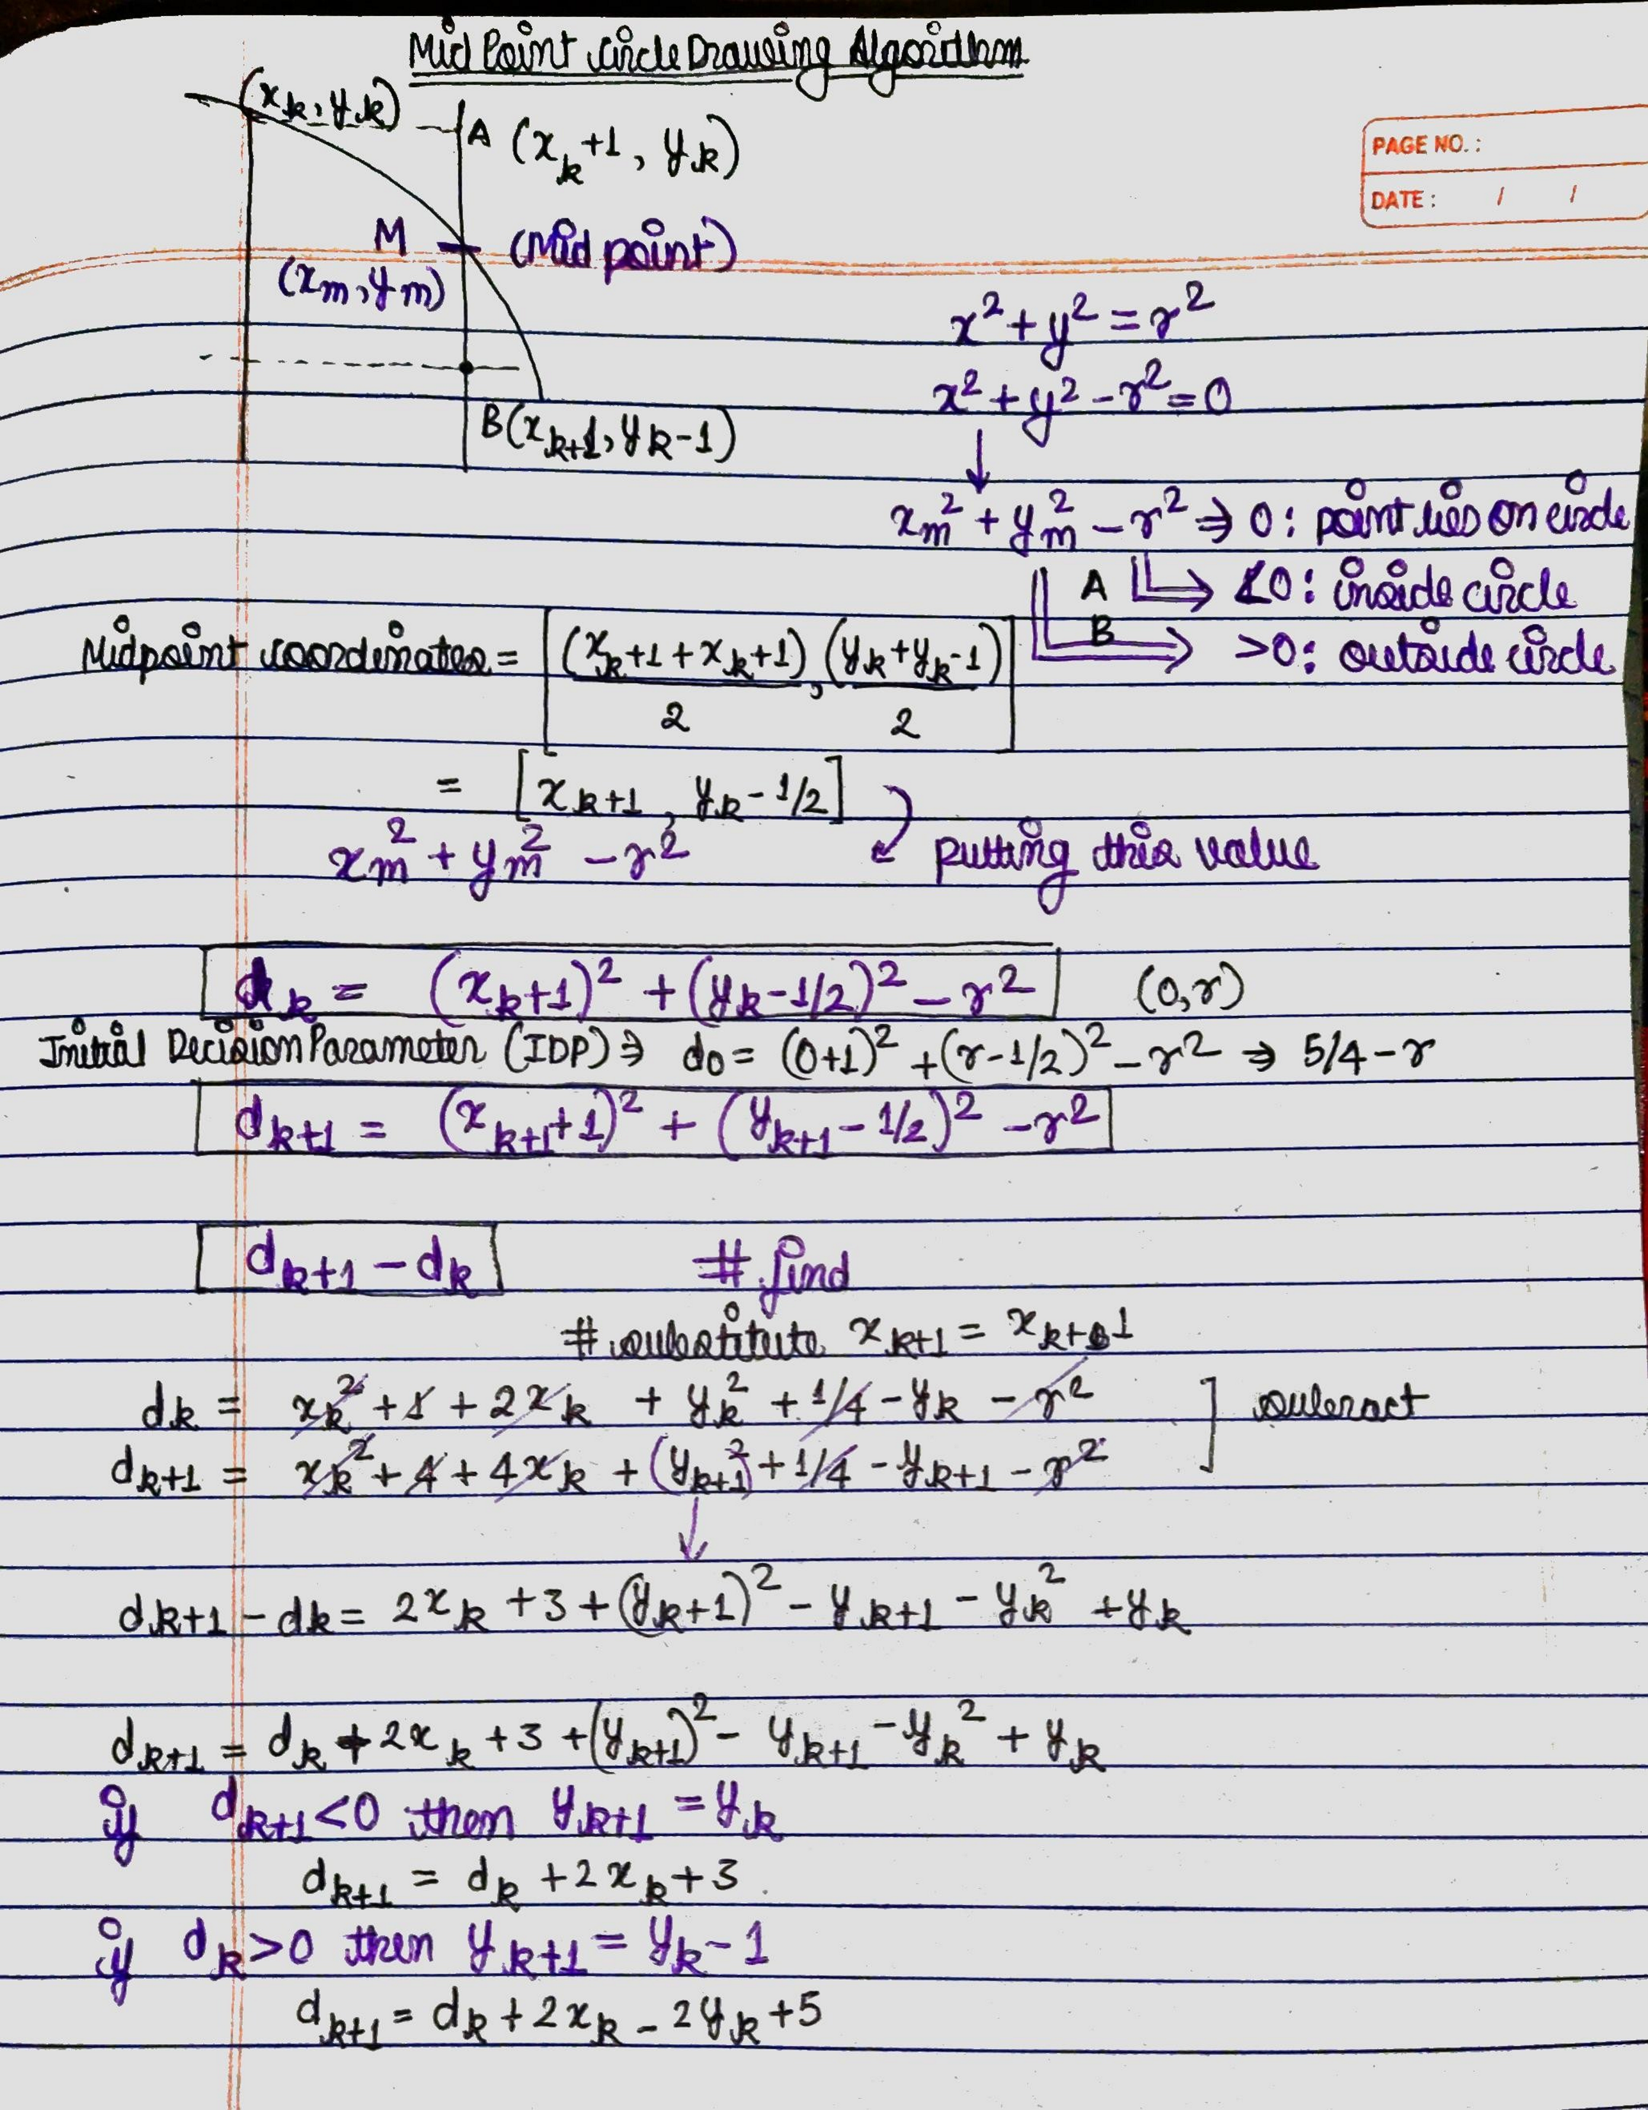















Mid Point Circle

Slide 31






Brensenham Circle

Slide 32













































Mid Sem-Practical

Slide 33
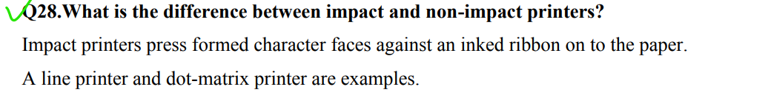
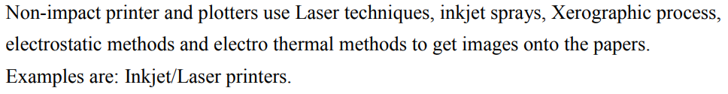







Viva Prep

Slide 34
Viva Prep

Slide 35
void DDA(int x1, int y1, int x2, int y2){ int dx= x2-x1; int dy= y2-y1; int steps= dx>=dy? abs(dx):abs(dy); float xinc= dx/(float)steps; float yinc= dy/(float)steps; int i= 0; cout<<xinc<<'\t'<<yinc<<endl; cout<<"\nThe consequent coordinates are: "<<endl; int x= x1, y=y1; cout<< "x0: "<<x<<", y0:"<<y<<endl; while (i<=steps) // while (i<=10) { /* code */ putpixel(x, y, RED); x+=xinc; y+=yinc; i++; cout<< "x_next: "<<x<<", y_next:"<<y<<endl; } putpixel(x, y, RED); }

Slide 36
void brensanham(int x0, int y0, int x1, int y1){ int x=x0; int y=y0; if (x0 > x1) { x = x1; y = y1; x1 = x0; y1 = y0; x0 = x; y0 = y; } int dx= x1-x0; int dy= y1-y0; int p= 2*dy-dx; while(x<x1){ if(p>=0){ putpixel(x,y,WHITE); y=y+1; p=p+2*dy-2*dx; } else{ putpixel(x,y,WHITE); p=p+2*dy; } x=x+1; } }

Slide 37
void drawMidPointCircle(int x0, int y0, int radius){ int y = radius, x = 0; int decisionParam = 1 - radius; while (x <= y) { putpixel(x0 + x, y0 + y, 1); putpixel(x0 - x, y0 + y, 2); putpixel(x0 + x, y0 - y, 3); putpixel(x0 - x, y0 - y, 4); putpixel(x0 + y, y0 + x, 5); putpixel(x0 - y, y0 + x, 6); putpixel(x0 + y, y0 - x, 7); putpixel(x0 - y, y0 - x, 8); delay(400); x++; if (decisionParam <= 0) decisionParam += 2 *x + 1; else{ y--; decisionParam += 2 * (x-y) + 1; } } }

Slide 38
void drawBrensanhamCircle(int x0, int y0, int radius){ int x = 0, y = radius; int decisionParam = 3 - 2 * radius; while (x <= y) { putpixel(x0 + x, y0 + y, RED); putpixel(x0 + y, y0 + x, RED); putpixel(x0 - y, y0 + x, RED); putpixel(x0 - x, y0 + y, RED); putpixel(x0 - x, y0 - y, RED); putpixel(x0 - y, y0 - x, RED); putpixel(x0 + y, y0 - x, RED); putpixel(x0 + x, y0 - y, RED); if (decisionParam <= 0){ x++; decisionParam += 4 * x + 6; } else{ x++; y--; decisionParam += 4 * (x - y) + 10; } } }

Slide 39
Traffic Light
void drawTrafficLight(int x, int y, int lightSize, bool isRedOn, bool isYellowOn, bool isGreenOn){
// Draw black background
setfillstyle(SOLID_FILL, BLACK);
bar(x, y, x + lightSize, y + 3 * lightSize);
// Draw red light
setfillstyle(SOLID_FILL, isRedOn ? RED : DARKGRAY);
circle(x + lightSize / 2, y + lightSize / 2, lightSize / 2);
floodfill(x + lightSize / 2, y + lightSize / 2, WHITE);
// Draw yellow light
setfillstyle(SOLID_FILL, isYellowOn ? YELLOW : DARKGRAY);
circle(x + lightSize / 2, y + lightSize + lightSize / 2, lightSize / 2);
floodfill(x + lightSize / 2, y + lightSize + lightSize / 2, WHITE);
// Draw green light
setfillstyle(SOLID_FILL, isGreenOn ? GREEN : DARKGRAY);
circle(x + lightSize / 2, y + 2 * lightSize + lightSize / 2, lightSize / 2);
floodfill(x + lightSize / 2, y + 2 * lightSize + lightSize / 2, WHITE);
}

Slide 40
Traffic Light
void red_circle()
{
setfillstyle(SOLID_FILL, RED);
circle(35, 35, 25);
floodfill(35, 35, WHITE);
}
void yellow_circle()
{
setfillstyle(SOLID_FILL, YELLOW);
circle(35, 85, 25);
floodfill(35, 85, WHITE);
}
void green_circle()
{
setfillstyle(SOLID_FILL, GREEN);
circle(35, 135, 25);
floodfill(35, 135, WHITE);
}
while (1)
{
rectangle(10, 10, 60, 160);
red_circle();
delay(400);
cleardevice();
rectangle(10, 10, 60, 160);
yellow_circle();
delay(400);
cleardevice();
rectangle(10, 10, 60, 160);
green_circle();
delay(400);
cleardevice();
}

Slide 41
Smiley
#include <graphics.h>
int main(){
// draw graphics using graphics.h
int gDriver = DETECT, gMode;
initgraph(&gDriver, &gMode, NULL);
// draw a circle
circle(200, 200, 100);
// draw a smile
arc(200, 200, 210, 330, 50);
// draw eyes
circle(170, 180, 5);
circle(230, 180, 5);
// draw a nose
line(200, 200, 200, 230);
getch();
closegraph();
return 0;
}

Slide 42
Hut
#include<graphics.h> int main(){
// draw a hut
int gDriver = DETECT, gMode;
initgraph(&gDriver, &gMode, NULL);
// draw a rectangle
rectangle(100, 100, 300, 300);
// draw a triangle
line(100, 100, 200, 50);
line(200, 50, 300, 100);
line(100, 100, 300, 100);
// draw a door
rectangle(150, 230, 200, 300);
circle(150, 150, 30);
circle(250, 150, 30);
getch();
closegraph();
return 0;
}

Slide 43
Important Functions of <graphics.h>
// Initializes the graphics system
void initgraph(int *graphdriver, int *graphmode, const char *path);
// Closes the graphics system
void closegraph();
// Waits for a key press event and returns the key code
int getch();
// Draws a pixel of specified color at the given (x, y) coordinate
void putpixel(int x, int y, int color);
// Draws a line between two given points
void line(int x1, int y1, int x2, int y2);
// Draws a rectangle with given top-left and bottom-right coordinates
void rectangle(int left, int top, int right, int bottom);

Slide 44
Important Functions of <graphics.h>
// Draws a circle with given center and radius
void circle(int x, int y, int radius);
// Draws an ellipse with given center, horizontal and vertical radius
void ellipse(int x, int y, int start_angle, int end_angle, int xradius, int yradius);
// Draws an arc with given center, radius, and start and end angles
void arc(int x, int y, int start_angle, int end_angle, int radius);
// Sets the current drawing color to the specified color
void setcolor(int color);
// Sets the fill pattern and color for the next fill operation
void setfillstyle(int pattern, int color);
// Writes the specified text string at the given (x, y) position on the screen
void outtextxy(int x, int y, const char *text);

Slide 45
Important Functions of <graphics.h> // Sets the font and size of the text to be drawn void settextstyle(int font, int direction, int charsize); // Returns the maximum x coordinate of the current graphics screen int getmaxx(); // Returns the maximum y coordinate of the current graphics screen int getmaxy(); void floodfill(int x, int y, int boundary_color);

Slide 46
Brensenham v/s DDA line generation
Accuracy: DDA line algorithm provides high accuracy for line generation, as it generates points based on the exact slope of the line. Bresenham algorithm, on the other hand, generates points based on integer arithmetic operations, which can result in some inaccuracies in the line.
Speed: Bresenham algorithm is faster than DDA algorithm, as it uses only integer arithmetic operations, which are faster than floating-point arithmetic operations used in DDA algorithm.
Efficiency: Bresenham algorithm is more efficient than DDA algorithm in terms of memory usage, as it requires only two variables to generate the line, whereas DDA algorithm requires variables for both x and y coordinates.
Implementation: Bresenham algorithm is more complex to implement than DDA algorithm, as it involves checking for multiple decision parameters and adjusting the values of these parameters based on the value of the error term. DDA algorithm, on the other hand, is relatively simple to implement, as it involves only basic arithmetic operations.
Applications: DDA algorithm is suitable for applications that require high accuracy in line generation, such as CAD systems and architectural design. Bresenham algorithm, on the other hand, is suitable for applications that require fast and efficient line generation, such as real-time graphics and video games.

Slide 47
Brensenham Circle v/s Mid Point Circle
Accuracy: Bresenham's algorithm is more accurate than the Midpoint algorithm. Bresenham's algorithm uses integer arithmetic and only calculates the points that lie closest to the actual circle, resulting in fewer rounding errors. Midpoint algorithm uses floating-point arithmetic, which can lead to some inaccuracies.
Efficiency: Midpoint algorithm is more efficient than the Bresenham's algorithm. The Midpoint algorithm uses only addition and subtraction, whereas Bresenham's algorithm involves division and multiplication operations, which can be more time-consuming.
Implementation: Bresenham's algorithm is harder to implement than Midpoint algorithm. Bresenham's algorithm is more complex, and it requires additional calculations for each octant of the circle. In contrast, the Midpoint algorithm is simpler and only requires one set of calculations.
Circle size: Bresenham's algorithm works better for small circles, while Midpoint algorithm works better for large circles. Bresenham's algorithm is limited by the accuracy of integer arithmetic, which can make it difficult to draw large circles. Midpoint algorithm, on the other hand, can handle larger circles without loss of accuracy.
Symmetry: Bresenham's algorithm has better symmetry than Midpoint algorithm. Bresenham's algorithm calculates points that are symmetric to each other along the circle, while the Midpoint algorithm doesn't.

Slide 48
Parametric Equations
Parametric equations are a way of representing geometric shapes such as lines and conics using parameters instead of the traditional x and y coordinates. These parameters can be either angles or distances, depending on the shape being represented.
The parametric equation of a line in two dimensions is usually written in the form:
x = x1 + t(x2 - x1)
y = y1 + t(y2 - y1)
where (x1, y1) and (x2, y2) are two points on the line, and t is a parameter that varies between 0 and 1. As t varies, the point (x, y) traces out the line segment connecting the two points.
For a conic section such as an ellipse, the parametric equation is written in terms of two parameters, usually denoted by u and v. For example, the parametric equation for an ellipse centered at the origin is:
x = a cos u
y = b sin u
where a and b are the lengths of the major and minor axes of the ellipse, respectively. As u varies from 0 to 2π, the point (x, y) traces out the entire ellipse.

Slide 49
Parametric Equations
Similarly, the parametric equation for a hyperbola can be written in terms of two parameters, usually denoted by u and v, as:
x = a cosh u
y = b sinh u
where a and b are again the lengths of the major and minor axes of the hyperbola. As u varies, the point (x, y) traces out the two branches of the hyperbola.
In general, the advantage of using parametric equations to represent geometric shapes is that they provide a more flexible and compact way of expressing complex shapes. They are also useful for animations and computer graphics, where the motion of a point along a path can be easily described using a parametric equation.

Slide 50
Plotters
A plotter is an output device that produces graphical output on paper or similar material. Plotters work by using one or more pens to draw continuous lines on the paper based on digital instructions sent to the device. Plotters are commonly used in engineering, architecture, and other fields where detailed graphical output is required.
There are two main types of plotters:
Drum Plotters: Drum plotters use a drum to rotate the paper, and the pens are moved along the drum's length to draw the lines.
Flatbed Plotters: Flatbed plotters use a flat surface to hold the paper and the pens are moved across the paper's width and length to draw the lines.

Slide 51
Printers
Printers, on the other hand, are devices that produce printed output on paper or other media. Printers work by transferring ink or toner onto paper to create text or images. There are several types of printers available, including:
Inkjet printers: Inkjet printers spray ink onto the paper to create text and images.
Laser printers: Laser printers use a toner cartridge and a laser to fuse the toner onto the paper.
Dot matrix printers: Dot matrix printers use a print head that strikes an inked ribbon to create the characters.
Thermal printers: Thermal printers use heat to transfer ink onto paper.
3D printers: 3D printers use various materials, such as plastic, to create three-dimensional objects layer by layer.

Slide 52
Impact vs Non Impact Printers
Impact printers work by physically striking an inked ribbon against the paper to create an image. The print head typically contains a series of pins or hammers that strike the ribbon, leaving ink on the paper. Examples of impact printers include dot matrix printers and daisy wheel printers. Impact printers are generally slower and noisier than non-impact printers, but they can produce carbon copies or multipart forms, and are often used for printing invoices, receipts, and other forms.
Non-impact printers, on the other hand, do not physically strike the paper. Instead, they use various technologies such as inkjet, laser, or thermal to create an image on the paper. Examples of non-impact printers include inkjet printers, laser printers, and thermal printers. Non-impact printers are generally faster and quieter than impact printers and produce higher quality output, but they cannot produce carbon copies or multipart forms.

